Slide 1
Introduction to R
Part 3

Slide 2
Topics covered
Algorithms
Flowcharts
Pseudocode
Variables
Mathematical precedence
Conditionals
Chaining
Loops

Slide 3
Algorithms

Slide 4
Algorithms
An algorithm is not a computer programme
A piece of R code is not an algorithm
A piece of R code is an implementation of an algorithm

Slide 5
Algorithms
An algorithm is an idea or proposed solution for solving a problem
It can comprise of clear sequence of instructions to solve a well-formulated computational problem specified in terms of its input and output.

Slide 6
Pattern count algorithm
Given two strings, Text and Pattern
To return the number of times Pattern occurs in Text
Input: Text, Pattern
Output: Count(Text, Pattern)

Slide 7
PATTERNCOUNT
Start
Start from the first position of Text and check whether Pattern appears in Text starting at its first position.
If yes, draw a dot on a piece of paper.
Move
Move to the second position of Text and check whether Pattern appears in Text starting at its second position.
If yes, draw another dot on the same piece of paper.
Continue
Continue until you reach the end of Text.
Count
Count the number of dots on the paper.
Notes:
Such an algorithm could comprise of 4 simple steps.
First, we initiate a counter from the first position of the text. This is similar to the start condition of the bubble sort algorithm.
At this position, you run a check for a pattern. If the pattern is identified, add 1 to a counter. If not, do nothing.
Then you move to the next position.
This will continue onwards until you reach the end of the text.
At which point, you return the final output, which is the count of the string patterns found along a piece of text.
Such an algorithm could be useful in biology. Suppose the pattern is ACTG, and we are looking for the numbers of this pattern along the length of a DNA sequence...

Slide 8
Conveying the idea of an algorithm
PATTERNCOUNT algorithm can be expressed informally as steps as shown earlier
This is acceptable and is sometimes referred to as Pseudocode
Another way of expressing and representing an algorithm is in the form of a flowchart

Slide 9
Pseudocode

Slide 10
Computers do not understand human language
Algorithms must be phrased in a programming language (such as Python, Java, C++, Perl, Ruby, Go, or dozens of others) in order to give the computer specific instructions.
Humans can understand English better than code, but we still need some ‘structure’ in describing the algorithm. So we need a compromise --- ‘pseudocode’.
Pseudocode emphasizes ideas rather than implementation details (ignoring many of the tedious details)
Pseudocode is more precise and less ambiguous than relating implementation details in plain English however.
Notes:
So far, I've only described algorithms in words. But they must be phrased in a programming language to provide clear and unambiguous instruction to a computer.
But if I want to communicate instruction to another person, talking computer code to him is not going to make me very popular. It also does not help much in the way of communication and mutual understanding.
And so, we need pseudocode to strike a compromise. But more importantly, note that the pseudocode emphasizes the idea, rather than the code itself. The logic and design, is all encapsulated in the pseudocode.
Note however, pseudocode is not like writing an english essay. It still requires some structure, and the use of some familiar constructs such as variables, operations and control statements.

Slide 11
DISTANCE
input is four numbers (x1, y1, x2, y2)
output is one number d
We want to calculate the euclidean distance between 2 coordinates
Notes:
Let us look at another example.
Here the input is 4 numbers, and we assign variable names x1, y1, x2, and y2.
You may immediate recognize that these are effectively cartesian coordinates.
The output is one distance number called that you can call d.
The purpose of this algorithm is to calculate a distance between 2 points in two dimensional space, with coordinates denoted by x and y.

Slide 12
Distance
Input x1, y1
Input x2, y2
Calculate the squared deviations between x2 and x1
Calculate the squared deviations between y2 and y1
Sum all the squared deviations
Calculate the squared root from sum of squared deviations
Is this precise enough?

Slide 13
Distance
Input x1, y1
Input x2, y2
Calculate the squared deviations between x2 and x1
Calculate the squared deviations between y2 and y1
Sum all the squared deviations
Calculate the squared root from sum of squared deviations
Is this precise enough?

Slide 14
DISTANCE
We can use any name we like for variable names.
For example, the following pseudocode is equivalent to the previous pseudocode for DISTANCE.
Notes:
Here is another way of writing the distance function.
Instead of d, we say, abracadabra.
and instead of coordinate names, we use x, y, z, w.
Would this be easier for someone else reading to quickly understand?

Slide 15
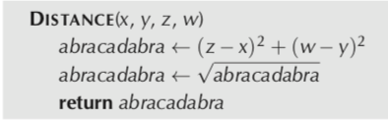
Distance
Input x1, y1
Input x2, y2
Calculate the squared deviations between x2 and x1
Calculate the squared deviations between y2 and y1
Sum all the squared deviations
Calculate the squared root from sum of squared deviations
Is this precise enough?

Slide 16
Biologists and Pseudocode
Computer scientists are accustomed to pseudocode, biologists might decide that pseudocode is too cryptic and therefore useless
Modern biologists deal with algorithms on a daily basis, the language they use to describe an algorithm may be closer to a series of steps described in plain English.
Some bioinformatics books are written without pseudocode. Unfortunately, this language is insufficient to describe the complex algorithmic ideas behind various bioinformatics tools that biologists use every day.
Notes:
Biologists need to understand pseudocode to communicate better with computer scientists. And also to develop better code logic themselves so that they could develop better solutions to well-defined problems.
Pseudocode is not plain English and has structure and meaning within. It is not loose and cryptic. And if expressed appropriately, it can meaningful convey instruction on logic and design, on algorithms that we need.

Slide 17
Representing algorithms: pseudocode
Pseudocode:
“Almost” code, but not quite...
Needs to be properly encoded in specific syntax to become programs
Algorithms in pseudocode will almost always take the form
Notes:
The begin and end are optional --- just to make things REALLY obvious.

Slide 18
A very loose way of expressing pseudocode
Specification: What is the largest integer?
INPUT: All the integers { … -2, -1, 0, 1, 2, … }
OUTPUT: The largest integer
Formulation:
Arrange all the integers in a list in decreasing order;
MAX = first number in the list;
Print out MAX;
Notes:
WHY is the above NOT an Algorithm?
(Hint: How many integers are there?)
Where are the potential ambiguities? Does the computer understand what is max? Does it understand what is decreasing order?

Slide 19
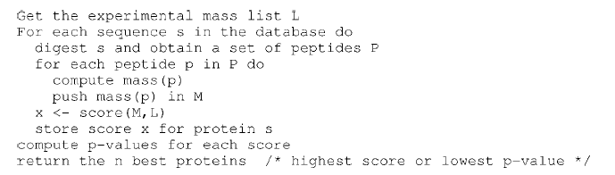
A more specific way of expressing pseudocode
Notes:
Objective:
We want to identify the protein based on its mass peaks
(This is effectively a pattern matching problem)

Slide 20
Flowcharts

Slide 21
What do we need to know about flowcharts?
The shapes have specific meaning
The flow of the logic is indicated by arrows
Must have a start and end point
Decision points are used to model different paths

Slide 23
1. A program allows a student to enter her numeric grade (an integer), and returns the letter grade, according to the following table. In case the grade is out of bounds, it returns "IMPOSSIBLE". Draw the flowchart and write the pseudocode for this program.

Slide 24
The desired input and output
Letter grade | Numeric grade
A | 10, 9
B | 8
C | 7
D | 6
F | 5,4,3,2,1,0

Slide 25
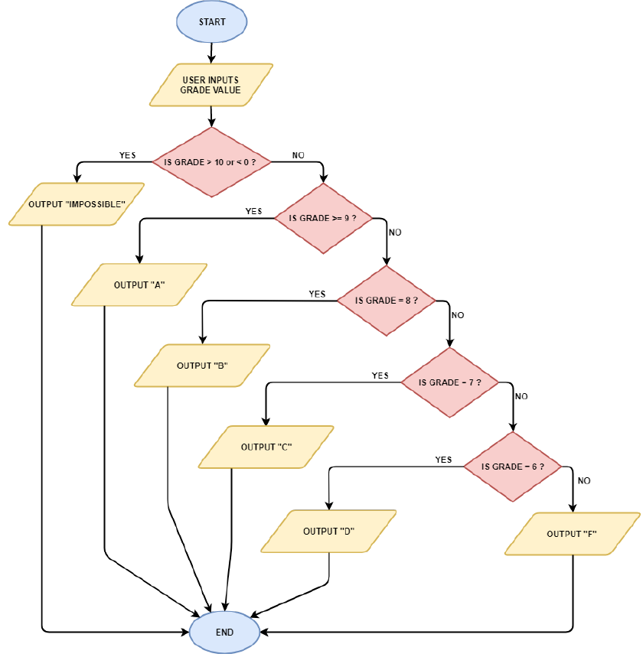

Slide 26
Algorithm, pseudocode and program
Algorithm
Pseudocode
An algorithm is conceptual.
A pseudocode is written in plain English to express the algorithm
Human readable but less exact
Program
Conversion of the pseudocode or algorithm into the formal instructions (syntax) used in a programming language
Machine readable instruction (very exact)

Slide 27
Variables

Slide 28
Variables
In statistics, a variable is a measurement of some quantifiable attribute. For example, height and weight are examples of variables.
In computer science, a variable is a container that can be filled with data.
A variable must be created (or instantiated) first
When a variable has no data, it is empty
E.g. the expression ‘A = ()’ creates an empty variable A with nothing in it
Filling up the container (variable) with some data requires a process called ‘assignment’
E.g. the expression ‘A = 5’ means I assign the value of 5 to A

Slide 29
Variables
Variables can take many forms
As a string/character type
e.g. “alice”, “paul”, “wilson”
As a numeric
e.g. 10, 100, 1000
As binary
1 or 0
As logical/boolean
True or False
Notes:
Ask yourself: Why the need to have so many types of variables? Well the obvious answer is that we need as many variable types as they are different types or categories of data.

Slide 30
Variables
Variables can be made accessible to any part of the program (global)
Variables are only made accessible to a fixed part of the program (local)
P.S. A function is an autonomous segment of code that performs a specific role; its internal processes are kept separate from the rest of the program (we will get to that later)
Discussion for class: Why do you think it is necessary to keep some variables limited to only parts of the programme?
Notes:
They may mention things like security. Coding ease and simplicity. They would not have yet understand programming styles.

Slide 31
Variables (in action)
Instantiation
A = ()
Assignment
A = 5
Reassignment
A = 10
Global and local variable (Is the value of A 5 or 10?)
A = 5
test = function(A)
{
A = 10
}

Slide 32
R also has a special assignment symbol
Normally when we assign a value to a variable, we use ‘=‘
In R, we may also use ‘<-’ in place of ‘=‘.
So A <- 5 is the same as saying A = 5
Try writing this in your R console:
A <- 5
A
A = 5
A

Slide 33
Variable types
A number (numeric)
A word (string)
Binary (basically 1 and 0)
Logical ( True or False)

Slide 34
Numeric
There are 2 kinds of numeric variables --- Integer and numeric (decimal/float)
By default, R considers all numerical input as “numeric”.
To know whether the variable is of numeric type, you use the is.integer() function.
Try the following code:
A <- 40
A
is.integer(A) #This evaluates to False
is.numeric(A) #This evaluates to True

Slide 35
Numeric
What if you die-die want the variable to be an integer?
In this case, you will have to perform coercion (force-convert).
To coerce a numeric-type variable to an integer-type variable, you use the function as.integer().
Try the following code:
A <- 40
A
A <- as.integer(A)
is.numeric(A) #is it true or false now?

Slide 36
Strings
A string in R is not something you use for tieing things up with
It is a collection of letters (inclusive of spaces) --- strings are commonly thought of as words
To know whether the variable is of string type, you use the is.character() function.
Try the following code:
A <- "my string” #must include quotation marks
is.character(A)

Slide 37
String
Strings can also comprise of numbers.
However, when a number is a string-type, no arithmetics can be performed on it.
To coerce a numeric-type to string-type, you use as.character().
Try the following code:
A <- 40
is.numeric(A)
A <- as.character(A)
is.numeric(A)
is.character(A)
A #notice the double quotes

Slide 38
Binary
You normally think of binary as simply 1s and 0s
But binaries are more than that, it is also a numbering system and also for encoding data in computers
For example:
Hexadecimal code
Although binary is an important variable type, it is not commonly dealt with in statistical computing, and R does not provide standard methods to deal with binary
And so we will move on.
Notes:
Each position in binary is a bit, so 1001 is 4 bits.
The maximum amount of alphanumeric information that we can encode in bits is 2 x 2 x 2 x 2 = 16 [note that each position is 1 or 0]
This is not enough to encode our basic alphabet. We now use the hexadecimal system which summarizes 16 bit data (in binary)
(0001 1110 0011)₂ = (1E3)₁₆ = (483)₁₀ where in ()_{x}, 2, 16 and 10 are for binary, hexa and decimal

Slide 39
Logical
Logical variables are also sometimes called Boolean
It has 2 data values only --- True and False
In R, you can initiate a logical variable by assigning True by writing:
A <- TRUE #note the capital letterings
A
is.logical(A)

Slide 40
Logical
You can coerce a logical-type to string-type using as.character()
Try the following code:
A <- TRUE
A <- as.character(A)
is.logical(A)
A #note the double quotes

Slide 41
Logical
Besides specifying the TRUE/FALSE directly, you may notice that you are already getting TRUE or FALSE messages when you are using functions like is.character()
You get a logical-type when evaluating a statement.
A <- 40 #a numeric
is.numeric(A) #TRUE
is.character(A) #FALSE
Evaluating statements in programming will always result in a logical-type being returned

Slide 42
Logical
Another way of evaluating a statement is by means of value comparison
Try the following code:
A <- 40 #a numeric
A > 40 #return False
The statement above will immediately return FALSE
This is because A is less than 40.
Although this may seem trivial for now, it is a fundamental concept to all programming.
We use the outcome of logical variables to control program flow

Slide 43
Logical
You can interconvert logical/boolean and binary
1 in binary is TRUE in logical/boolean
0 in binary is FALSE in logical/Boolean
To do this, try:
as.logical(1) #returns TRUE
as.logical(0) #returns FALSE
as.numeric(TRUE) #returns 1
as.numeric(FALSE) #returns 0
This is a very useful relationship for programming shorthand, but for now, let’s leave it.

Slide 44
Mathematical precedence

Slide 45
What is statistical programming without access to mathematical operators?
Multiplication (use *)
5 * 5
Addition (use +)
5 + 5
Subtraction (use -)
5 - 5
Division (use /)
5/5
Modulus (use %%)
5 %% 5
Power (use ^)
5 ^ 5

Slide 46
Use mathematical operations with logical
Using addition and comparing against some other number
5 + 5 < 9 #returns FALSE
5+5 == 10 #returns TRUE

Slide 47
Mathematical precedence
R programming follows basic mathematical precedence (Division > Multiplication > Division > Subtraction)
However, complex mathematical relationships can be difficult to read and follow
To order to force the order of relationships, we may use round brackets “()”. Anything within the round brackets is computed first (Top priority)

Slide 48
Precedence in mathematical operators
Try the following code:
9 + 1/5
(9+1)/5
9+ (1/5)
What is the difference? Note that in the third example, it had no effect. Division takes precedence over addition anyway
The use of the brackets can also help make things clearer for eyes to follow. For example, if we dealt with 2 fractions
1/5+1/2 #this isn’t so nice to read
(1/5) + (1/2) #it is very clear we are adding 2 fractions now

Slide 49
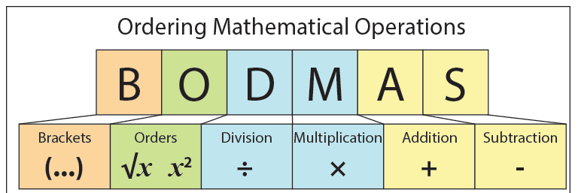
Mathematical precedence

Slide 50
Conditionals

Slide 51
Conditionals
An conditional operation evaluates a line of code to see if it meets some condition
If the condition is met, then it is true.
If the condition is not met, then it is false
Common examples of operators: ‘if’ and ‘if + else’

Slide 52
Conditionals

Slide 53
Conditionals
Let mark be the total-mark obtained
if (mark < 40)
then (print “Student fail”)
else (print “Student pass”)
endif
…

Slide 54
Conditionals
read in mark (*from a list*)
if (mark < 40) then (Grade ← “F”)
else if (mark < 50) then (Grade ← “D”)
else if (mark < 60) then (Grade ← “C”)
else if (mark < 70) then (Grade ← “B”)
else if (mark < 80) then (Grade ← “A”);
endif
print “Student grade is”, Grade
…
Notes:
Qn: what do you think will happen if I made mark < 80 then grade A be the first statement?

Slide 55
Conditionals
Implement the pseudocode in R
Try to be as detailed as you can

Slide 56
Chaining

Slide 57
You will realize that IF conditions are basically testing for a logical outcome
Logical/Boolean can be chained together using AND and OR operators
AND and OR are also known as Boolean operators
Syntax alert!
AND in R is represented by ‘&&’
OR in R is represented by ‘||’

Slide 58
The AND operator
AND returns TRUE only if both conditions are also simultaneously fulfilled (i.e., returns as TRUE)
You can also understand this by looking at the Venn diagram below where rivers AND salinity only returns the intersection between them

Slide 59
The AND operator
First variable | Operator | Second variable | Outcome
TRUE | AND | TRUE | TRUE
FALSE | AND | TRUE | FALSE
TRUE | AND | FALSE | FALSE
FALSE | AND | FALSE | FALSE

Slide 60
The OR operator
OR returns TRUE if either condition is fulfilled (i.e., returns as TRUE)
You can also understand this by looking at the Venn diagram below where fruit OR vegetable returns the entire area

Slide 61
The OR operator
First variable | Operator | Second variable | Outcome
TRUE | OR | TRUE | TRUE
FALSE | OR | TRUE | TRUE
TRUE | OR | FALSE | TRUE
FALSE | OR | FALSE | FALSE

Slide 62
Boolean chaining
What is the output from:
False and True and True or False or True and False

Slide 63
Boolean chaining
False and True and True or False or True and False
(False and True) and (True or False) or (True and False)
False and True or False
False or False
False

Slide 64
What is the practical significance of chaining Boolean?
When you have multiple conditions that need to be fulfilled in some manner
Like finding an ideal marriage partner!
Must be Kind
Must be Smart
Must be Rich
Must be Asian
Which denotes a stronger requirement?
Kind AND Smart AND Rich AND Asian?
Kind AND SMART OR Rich OR Asian?

Slide 65
What is the practical significance of chaining Boolean?
You can also do chaining with numerical comparisons
The syntax for AND in R is double or single ampersand (&& or &)
Try:
measured_BP <- 130
#A good blood pressure needs to be below 140 and also above 90
(90 < measured_BP) && (measured_BP < 140) #This returns as TRUE

Slide 66
What is the practical significance of chaining Boolean?
You can also do chaining with numerical comparisons
The syntax for OR in R is ||
Try:
measured_BS <- 40
#If your blood sugar level is below 50 mg/dL, it is too low.
#If your blood sugar level is above 150 mg/dl, it is too high
(50 > measured_BS) || (measured_BS > 150)
#This returns as TRUE since only one of the conditions need to be fulfilled

Slide 67
Other Boolean Operators
AND and OR are the most common Boolean Operators.
Others such as NOT, and AND NOT also exist

Slide 68
Loops

Slide 69
Loops
Loops allow us to repeat a block of code many times over
Until some condition is met
Otherwise… will run for eternity or until the computer crashes
Most common control statements
For loops
While loops

Slide 70
Why do we want to loop?
Consider the following problem: I want to add the following numbers from 1, 2, 3, 4, …10.
One way of doing this is to manually write 1 + 2 + … + 10
But what if I want to add from 1 to 100? This would be very inefficient
One elegant solution to resolve this “verbose” issue is to write a loop

Slide 71
An example of a for-loop in R
n = 10
count = 0
for (i in 1:n)
{
count <- count + i
}
count

Slide 72
There are 4 main components in a loop
Initialize
Initialize (set up a control variable that controls the loop)
Test
Test (do we continue running the loop?)
Loop
Loop body (part that needs to be repeated)
Update
Update (update the control variable)

Slide 73
Control statements (for-loop)
Notes:
After the b^{th} round, the program will terminate
Ask the student what does <- mean? (this is assignment the value of a to j). If a smaller than b? if a is bigger than b, what happens?
What does j <- j + 1 mean? Is j always smaller than b? is j always bigger than a? what happens if j is bigger than b?

Slide 74
An example of a while loop in R
n = 10
i = 1
count = 0
while (i <= n)
{
count <- count + i
i <- i + 1
}
count
Notes:
Let’s discuss what is going on here

Slide 75
Control statements (The While Loop)
Can condition ever evaluate to false in the statement above?

Slide 76
Comparing the for and while loops next to each other
for j ← 1 to 4 do
print 2*j;
endfor
print “--- Done ---”
j ← 1;
while (j <= 4) do
print 2*j;
j ← j + 1;
endwhile
print “--- Done ---”
Output:
2
4
6
8
--- Done ---
Output:
2
4
6
8
--- Done ---
These two blocks of code do the same thing.
Yet, how are they different?

Slide 77
R Data structures

Slide 78
Data structures in R
Data types can be assembled into larger and more complex entities called data structures
R offers a wide variety of data structures for satisfying different task requirements

Slide 79
Data structures in R
Factor
List
A
A
B
B
-a collection of entities with different lengths
multiple types
Multiple data structures (vectors, matrices and data frames)
-It is 1 column or row
-Contains “level” data which describes “levels” of classification e.g. class label A or B

Slide 80
End of Segment
Let’s take a break

